Slide 1




Project Bootcamp Program
Bank Analytics Project.
Presentation by Faizan
Presentation By Group

Slide 2





Objectives
Year-Wise Loan Amount Statistics:
To understand the trend in loan amounts over different years.
Grade and Sub-Grade Wise Revolving Balance:
To analyze the distribution of revolving balances across different loan grades and sub-grades.
Total Payment for Verified Status vs. Total Payment for Non-Verified Status:
To compare the payment behavior of verified versus non-verified borrowers.
State-Wise and Month-Wise Loan Status:
Bank
To analyze the geographical and temporal distribution of loan statuses
Home Ownership vs. Last Payment Date Stats:
To examine the relationship between home ownership and the timing of the last loan payment.
By achieving these objectives and goals, the project aims to enhance the bank's decision-making processes, improve risk management, and optimize loan portfolio performance.

Slide 3






Year-Wise Loan Amount Statistics:
Objective: To understand the trend in loan amounts over different years.
Goal: Identify growth patterns, peak periods, and any significant changes in loan disbursements.
Analyzes loan amounts over different years to identify growth patterns, peak periods, and significant changes, providing insights into loan disbursement trends and helping in strategic planning.

Slide 4
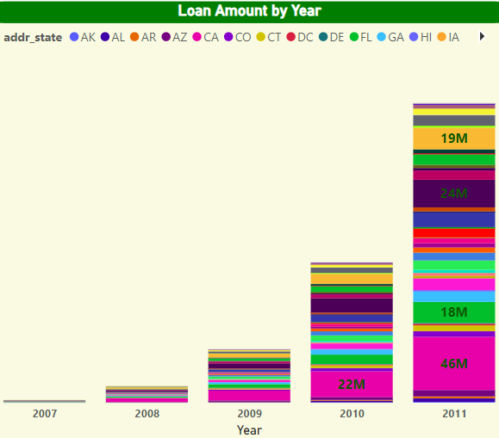
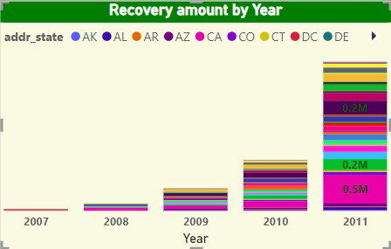
Every year there is a high percentage Change in loan amount but the maximum change that we observe is in 2011.
State CA has the maximum change by year in loan amount as well as in recovery amount we should open more branches there.
For the upcoming year 2012, we should be ready for more loan amounts to grow our business.
State CA

Slide 5
Grade and Sub-Grade Wise Revolving Balance.
Objective: To analyze the distribution of revolving balances across different loan grades and sub-grades.
Goal: Assess risk levels and creditworthiness of borrowers based on their grades and manage the bank’s credit exposure.
Examines revolving balances across loan grades and sub-grades to assess borrower risk levels, aiding in credit risk management and optimization of the bank's credit exposure.

Slide 6
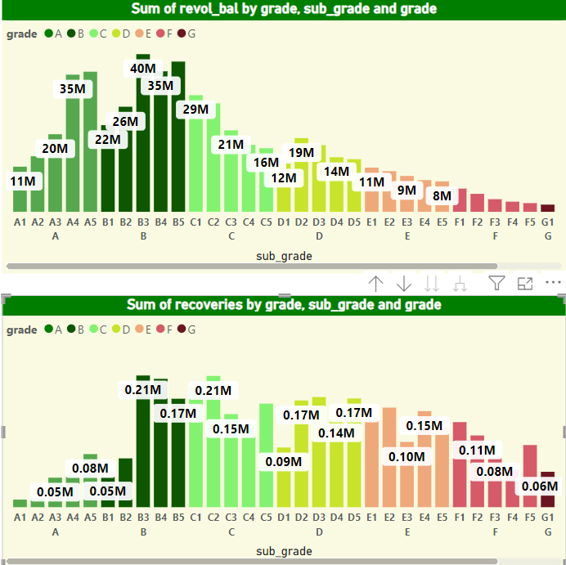
Grade B has the highest revolve balance grade A has the second highest revolve balance but grade A has the least recovery amount hence we must on other grades to ignore bad debts. We can focus on grade F to increase revolve balance.
Grade F has the maximum ratio in recovery amount hence we should more focus on grade F to increase the sale of loans in this grade.

Slide 7
Total Payment for Verified Status vs. Non-Verified Status:
Objective: To compare the payment behavior of verified versus non-verified borrowers.
Goal: Determine the impact of verification on repayment reliability and inform future loan approval processes.
Compares payment behaviors between verified and non-verified borrowers to determine the impact of verification on repayment reliability, informing future loan approval processes.

Slide 8
State-Wise and Month-Wise Loan Status:
Objective: To analyze the geographical and temporal distribution of loan statuses.
Goal: Identify regional and seasonal trends in loan performance to tailor marketing and risk management strategies.
Analyzes loan statuses by state and month to identify regional and seasonal trends, aiding in the customization of marketing and risk management strategies

Slide 9
Home Ownership vs. Last Payment Date Stats:
Objective: To examine the relationship between home ownership and the timing of the last loan payment.
Goal: Understand how home ownership influences repayment behavior and loan performance, which can inform lending policies and risk assessments.
Examines the relationship between home ownership and the timing of last loan payments to understand its influence on repayment behavior, informing lending policies and risk assessments.

Slide 10

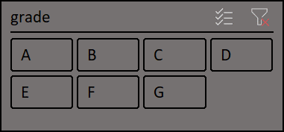
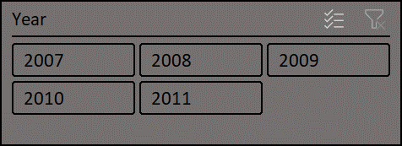
Bank Analytics Project.
Average YOY Growt%h
Total Loan Amount.
Avg Verified. Avg Not Verified.
67.2
445602650
14439.51
9074.02

Slide 11




Target Audience
Risk Management Teams:#1
Financial Analysts #2
Marketing and Sales Teams #3
To enhance credit risk assessment and develop strategies for mitigating potential risks.
To support detailed analysis and reporting on the bank’s loan portfolio performance.
To identify trends and tailor marketing strategies for different regions and customer segments.

Slide 12

Group 4 : Presentation
THANK YOU

